Slide 1
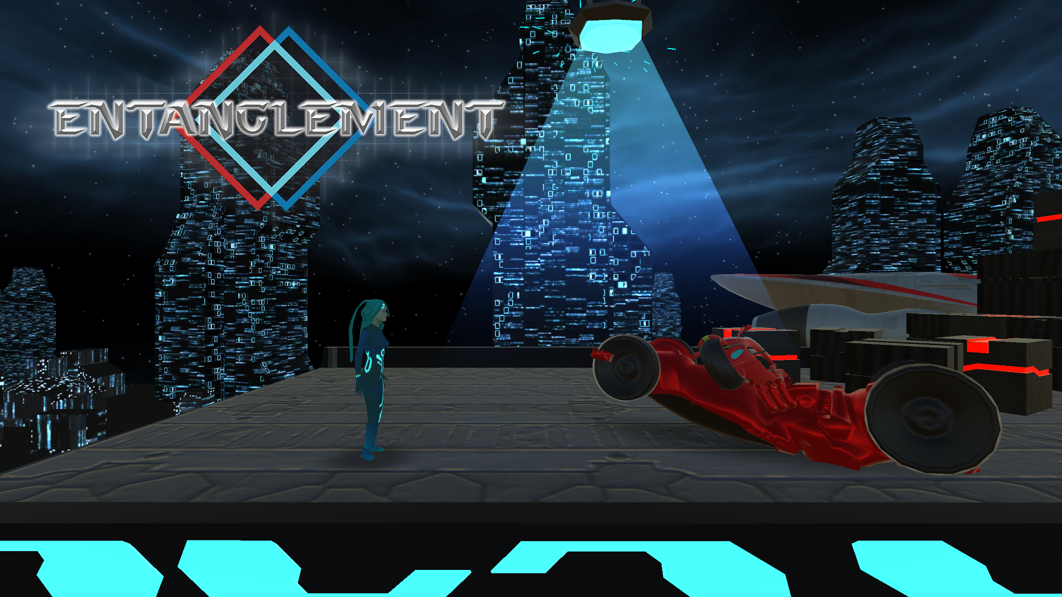


Slide 2

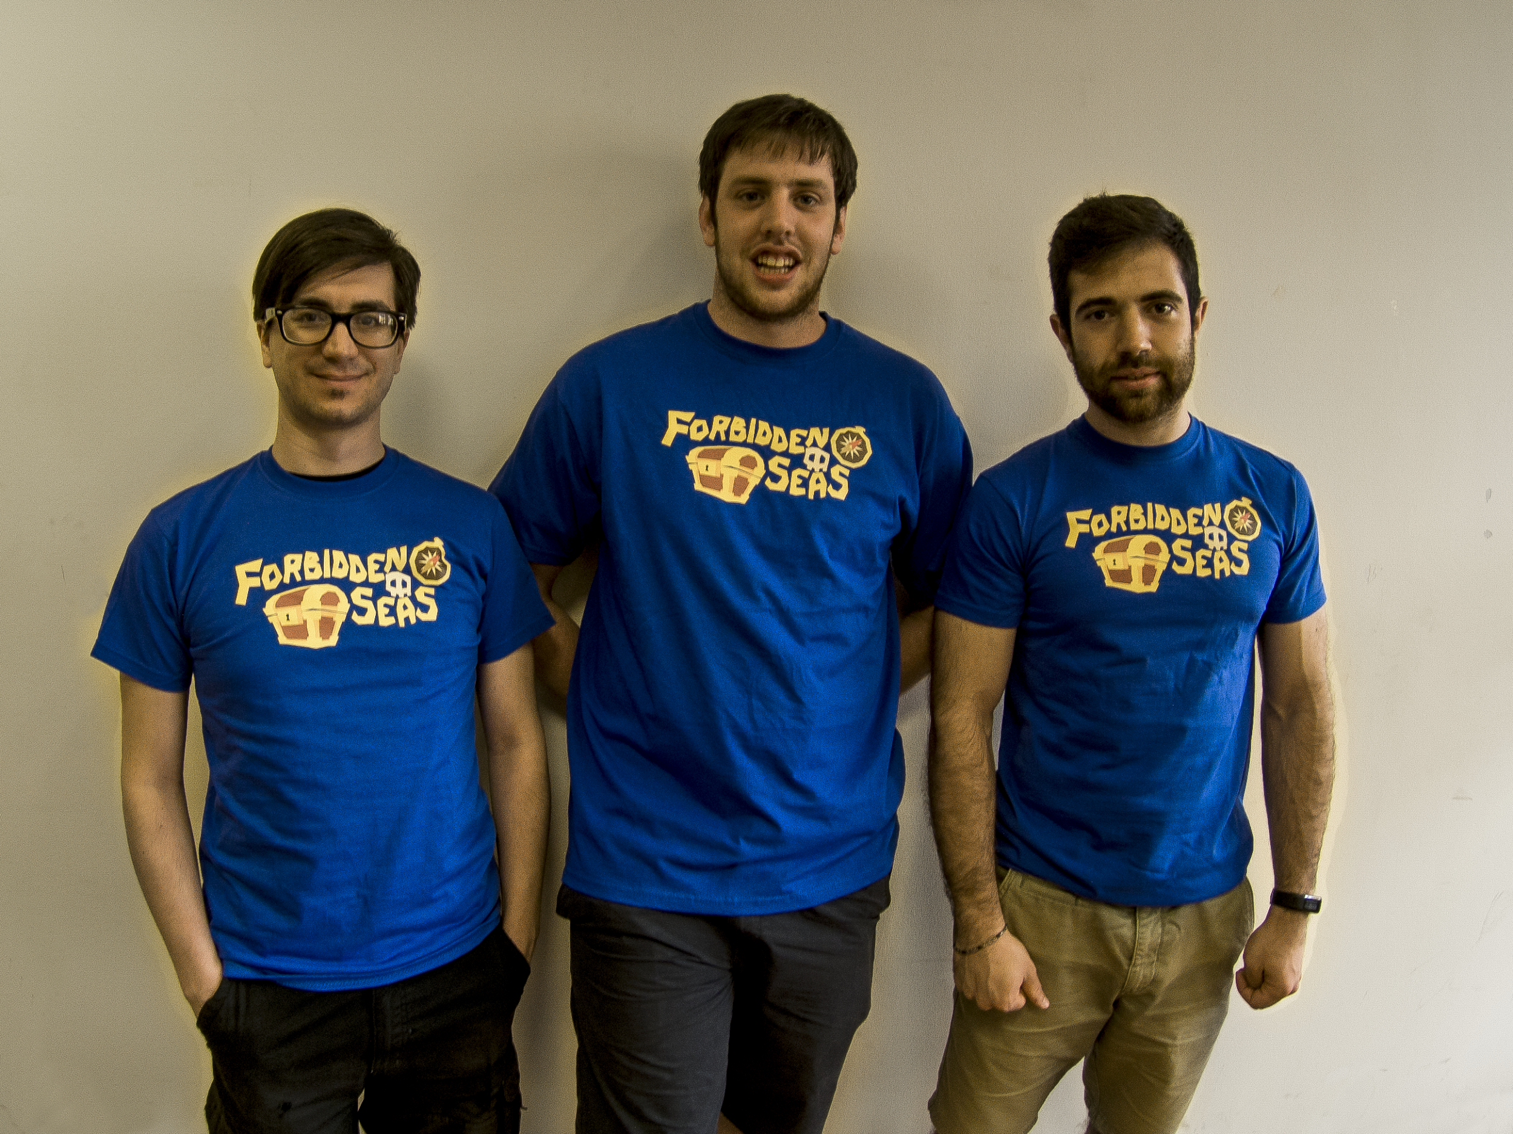
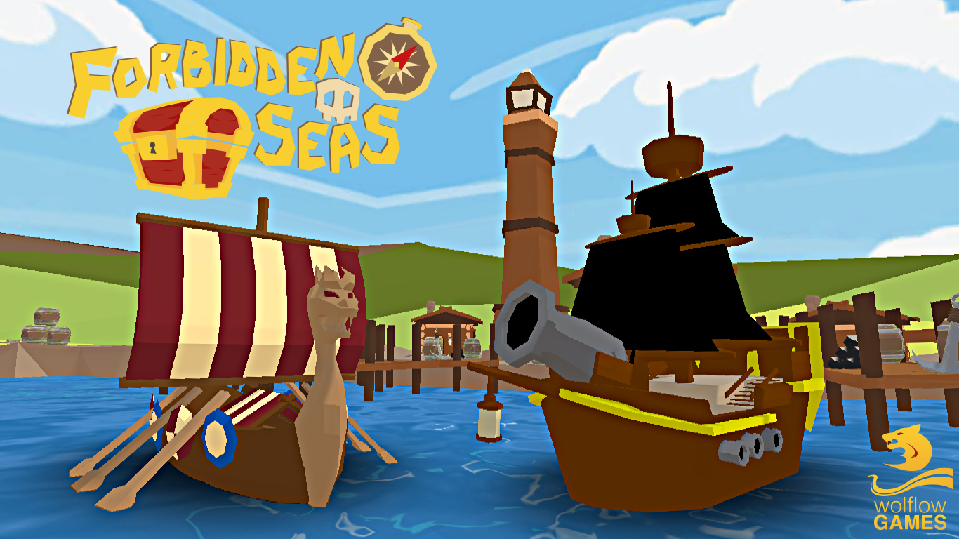
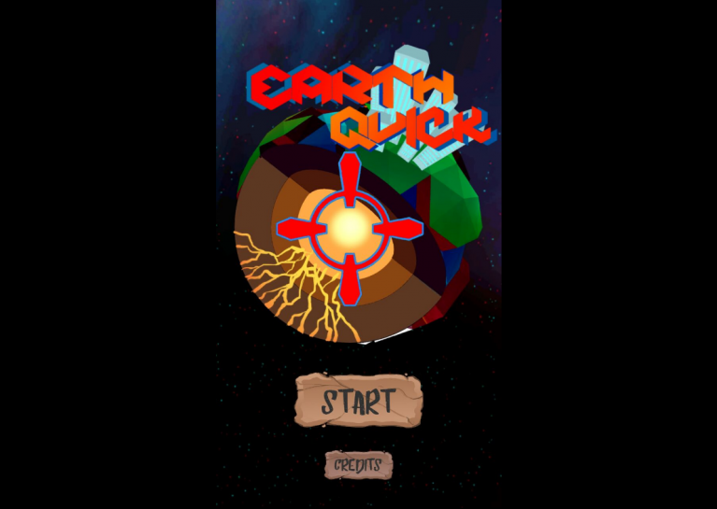
Development Team
wolflow games was born in 2016, founded by Matteo Marras, Alberto Ronchetti and Manuel Salvadori, based in Milan.
Forbidden Seas - PC
EarthQuick - Android

Slide 3
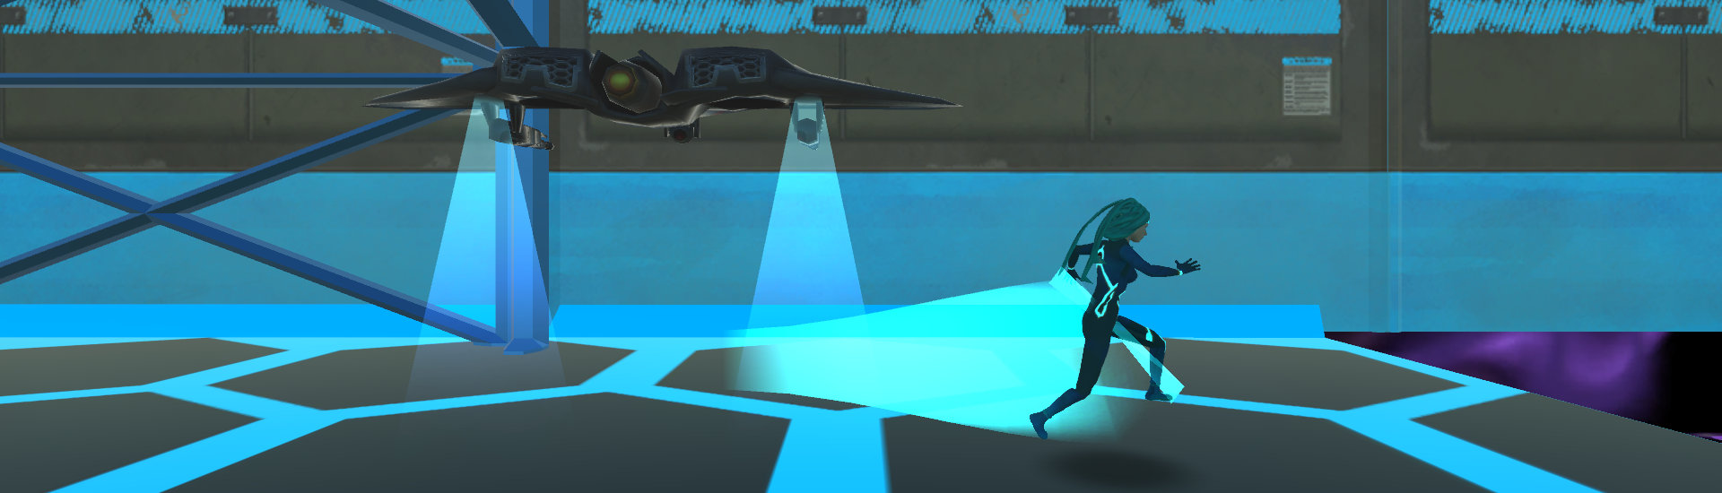
Project ID
Working Title: Entanglement
Genre: Platform/Puzzle
Format: PC and consoles Scope: digital only Target audience: midcore players
N. Players: single player
Engine: Unity
“Super Paper Mario with two characters in Sci-Fi setting”

Slide 4
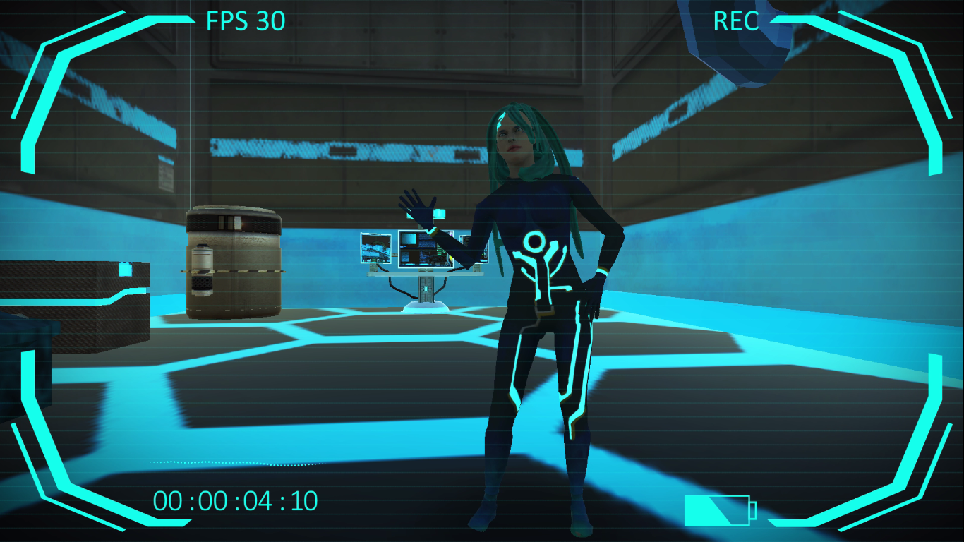
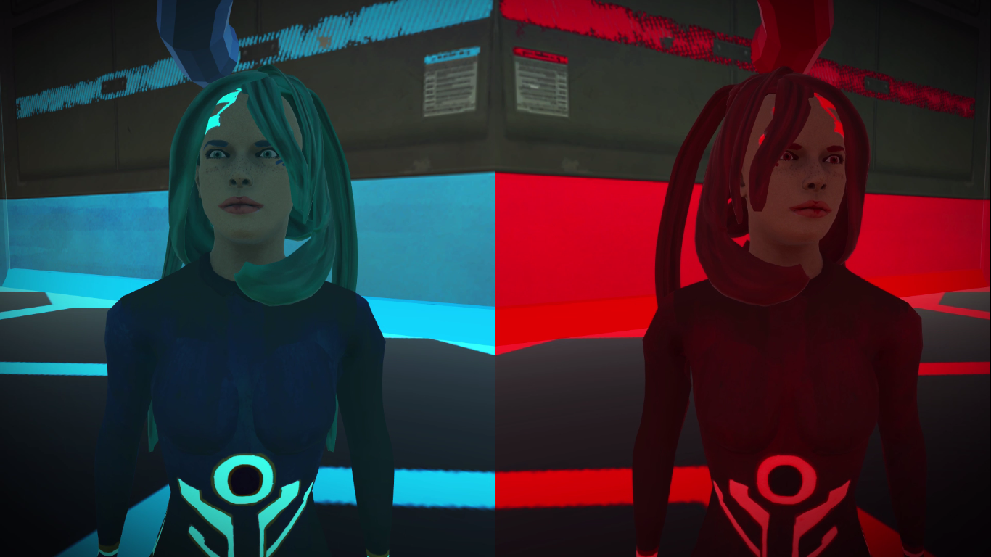
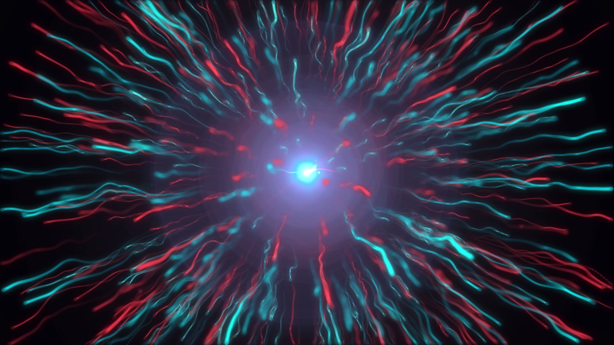
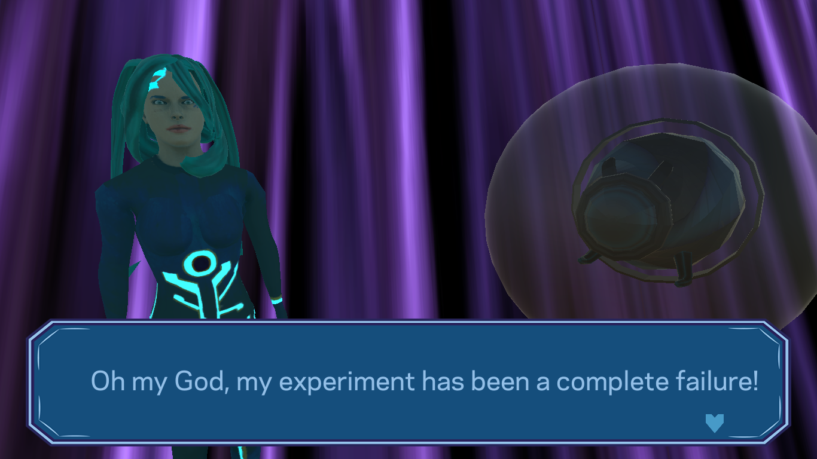
Story
“Two scientists, an evil machine, an entangled hope to save the dimensions”
After a failed experiment in her lab, the Doc discovers a fracture between two parallel dimensions.
An evil device is released from his dimensional cage and threatens to destroy everything.
The Doc now have to face the danger and help her alter-ego in the second dimension in order to fix the fracture and to defeat the evil device!

Slide 5

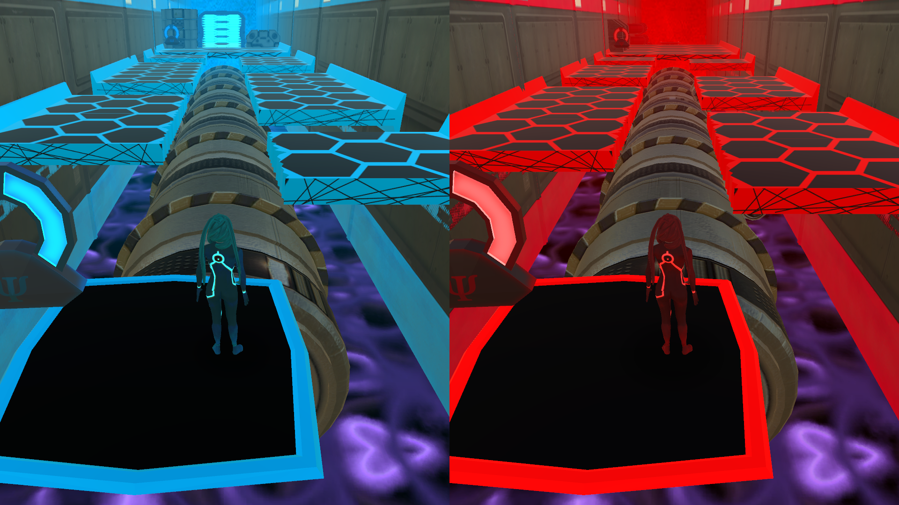
Unique Selling Points
Blend between 2D and 3D gameplay
Two characters at the same time
It’s only a perspective matter
Puzzles need cooperation between
the two characters

Slide 6
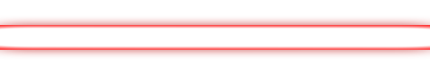
Budget and Schedule
250k € Total
2 years of development
Jen 2017
Prototype
Sept 2018
Alpha
Nov 2018
Beta
Apr 2019
Final Release

Slide 7
Executive Summary
Platform + puzzle
2D + 3D
Story driven gameplay
Total budget 250k €
Release window Q2 2019
Breakeven estimation ~ 25k copies

Slide 8

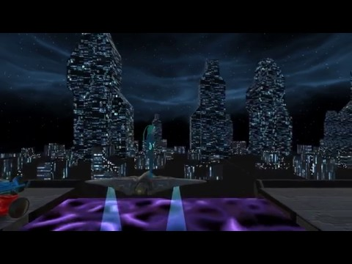

wolflow games
Milan
/entanglementvideogame
Matteo Marras
Alberto Ronchetti
Manuel Salvadori

